Slide 1
Applications of Retrieval- Augmented Generation
(RAG)
Yue Zhang & Joseph Rissman
CS688 Fall 2024

Slide 2
Contents
Problem Statement (Limitations of Large Language Models)
Introduction to Retrieval-Augmented Generation (RAG)
An Application on Biological Question Reasoning

Slide 3
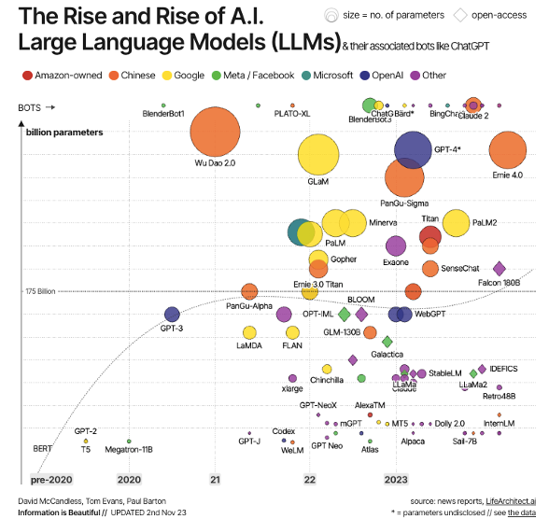
Rapid Growth of LLMs in Recent Years

Slide 4
Potential Challenges Facing LLMs
Computation and Memory: Expensive to compute a large number of tokens
Difficult to fine-tune: The size of a large language model (LLM) can range from 1–2 billion to over 1.75 trillion.
Contextual Understanding: Knowledge for LLM is static. 95% the world’s data is “private”. Require maintaining a comprehensive knowledge warehouse.
https://medium.com/@InferenzTech/why-rag-still-matters-beyond-token-limits-in-llms-289d16a930af

Slide 5
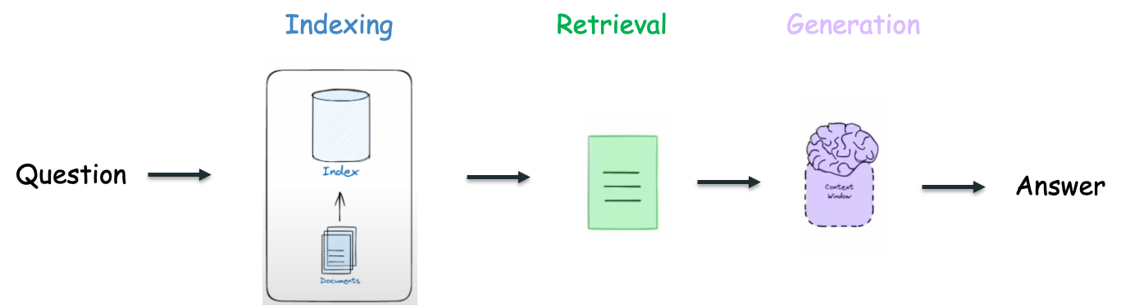
RAG: Retrieval-Augmented-Generation
Retriever: Identifies and retrieves relevant documents
Generator: Take retrieved docs and the input query to generate coherent and contextually relevant response
https://github.com/langchain-ai/rag-from-scratch

Slide 6
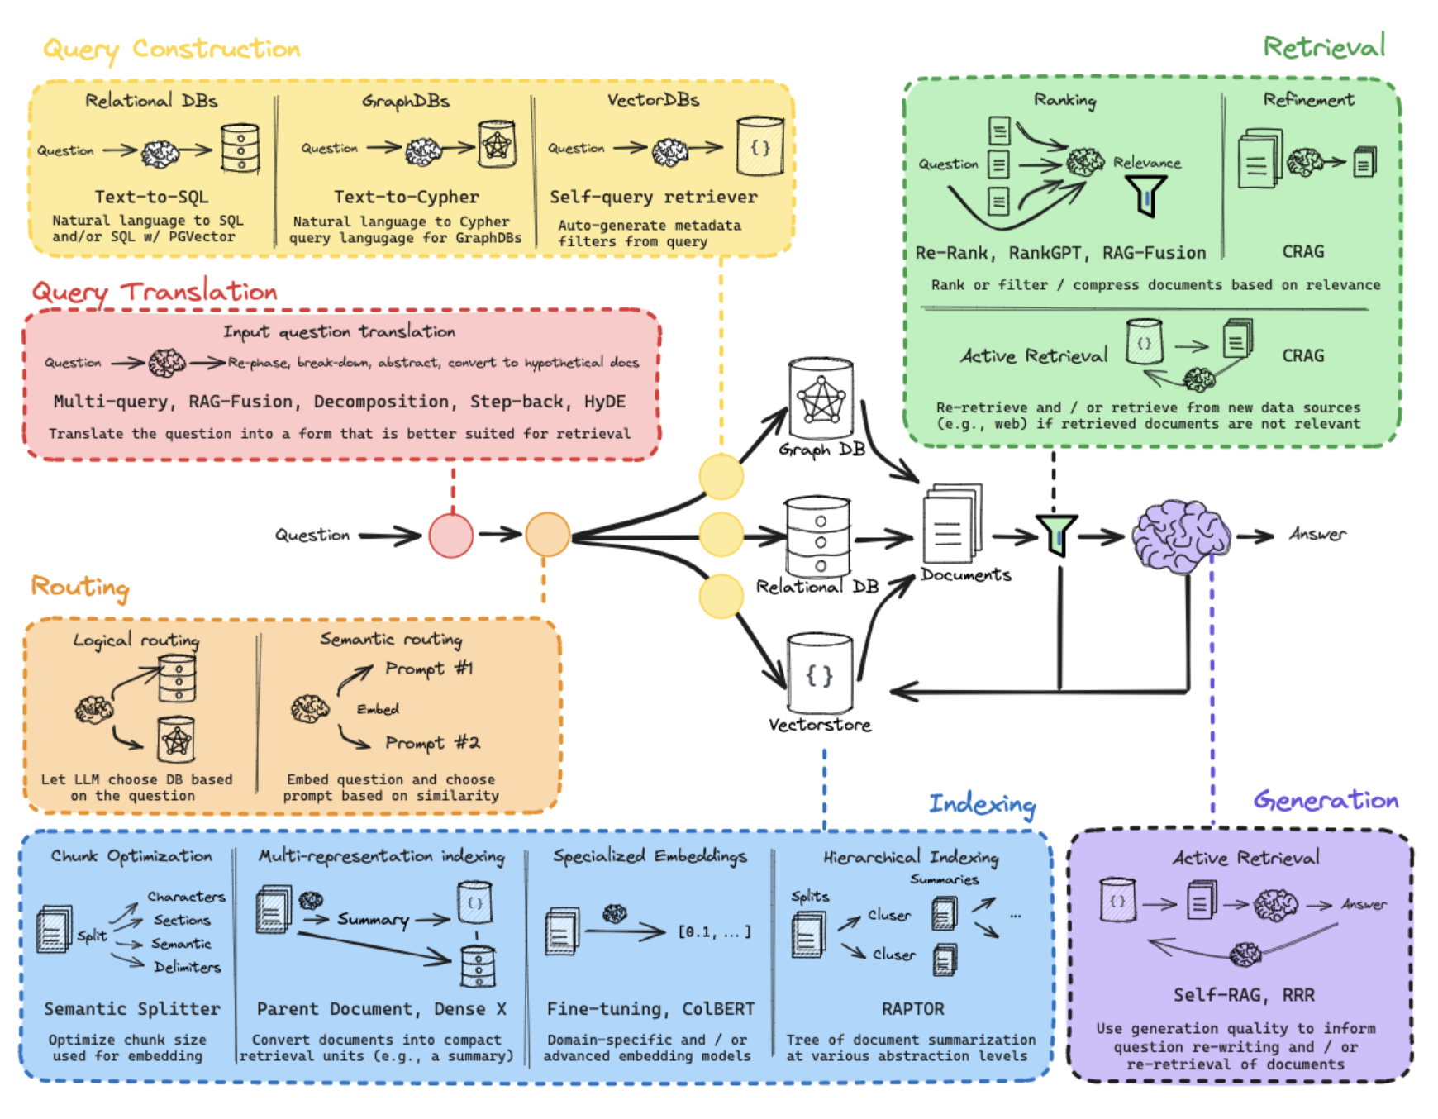
RAG Landscape Overview
https://github.com/langchain-ai/rag-from-scratch

Slide 7
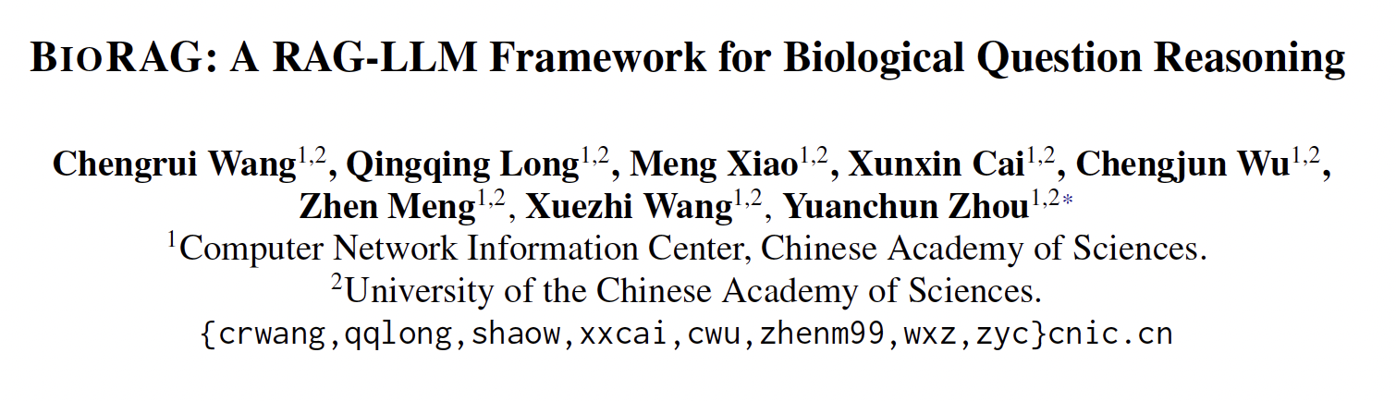
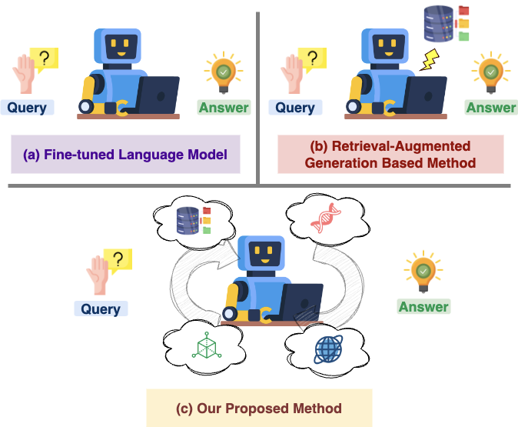
An Application on Biological Question Reasoning

Slide 8
Problem Statement
(C1) The scarcity of high-quality domain-specific corpora.
(C2) The inherent complexity of biological knowledge systems.
(C3) The continual updating of knowledge.

Slide 9
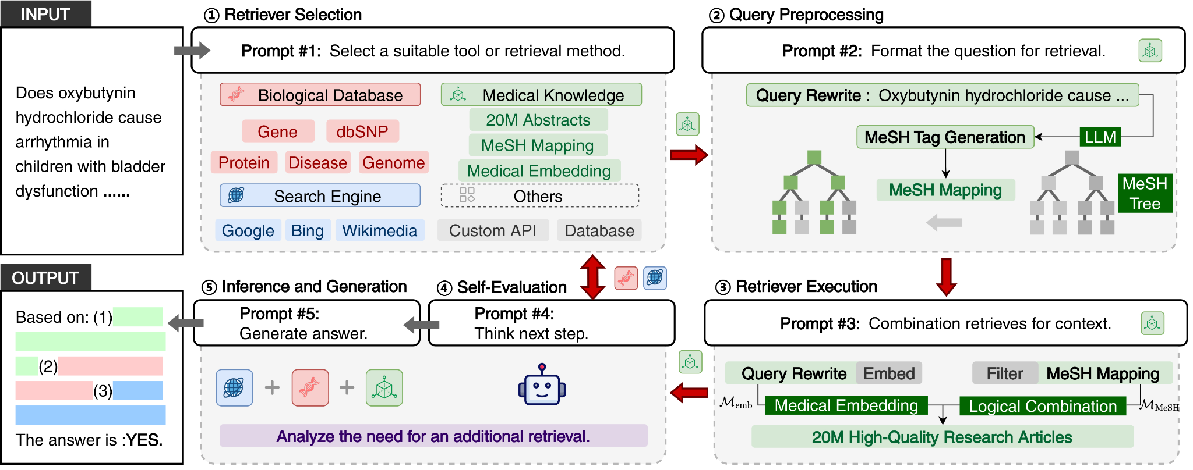
The architecture of BioRag framework

Slide 10
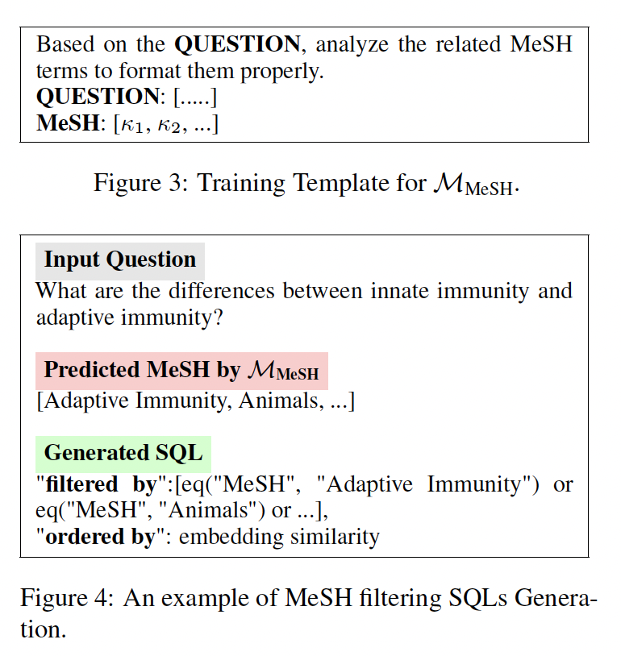
Self-evaluated Information Retriever

Slide 11
Customized Prompts Detail
Prompt # 1: To provide the most helpful and accurate response to the following Question: {Question}. You have been given descriptions of several RETRIEVAL METHODS: {Retrieval}. Please select the RETRIEVAL METHODS you consider the most appropriate for addressing this question.
Prompt # 2: Based on the RETRIEVAL METHODS you selected, and considering the Question and the Input Requirements of the retrieval method, please REWRITE the search query accordingly.
Prompt # 3: Using the rewritten QUERY and the retrieval FILTER methods, perform a logical combination to execute the search effectively.
Prompt # 4: Based on the RETRIEVAL RESULTS from the above steps, please evaluate whether the RESULTS support answering the original Question. If they do not support it, output "NO". If they do support it, output "YES".
Prompt # 5: Based on the RETRIEVAL RESULTS, perform a comprehensive reasoning and provide an answer to the Question.

Slide 12
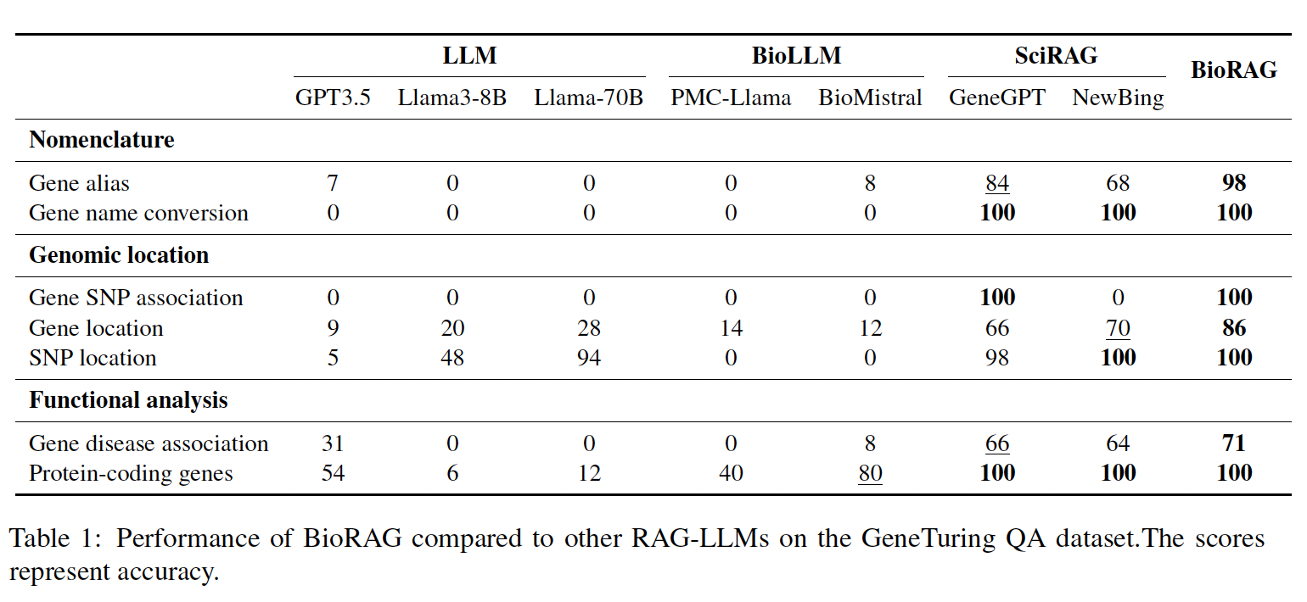
Performance comparison: BioRAG vs other RAG-LLMs

Slide 13
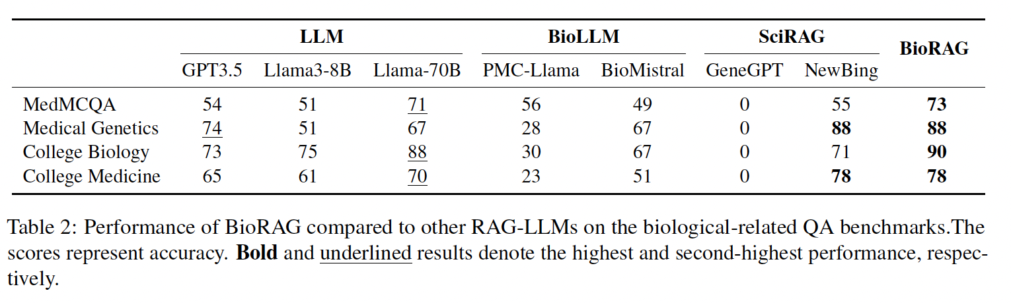
Performance comparison: BioRAG vs other RAG-LLMs

Slide 14
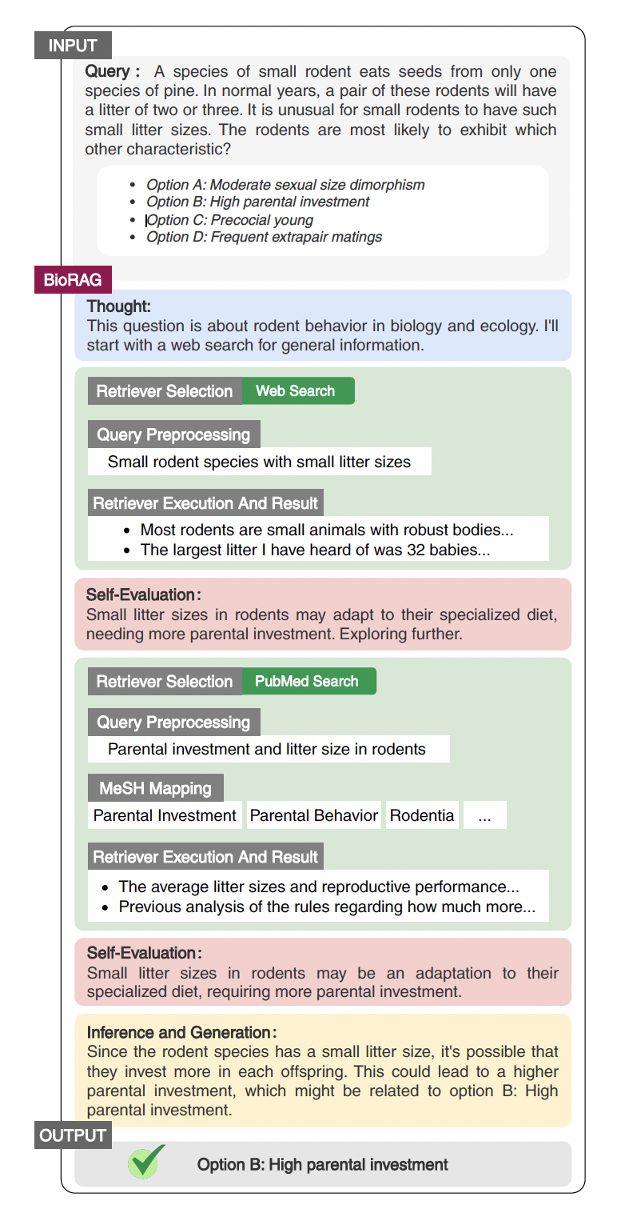
Case study

Slide 15
Conclusion
RAG Enhances LLM Performance: Integrating Retrieval-Augmented Generation improves the ability of Large Language Models to address knowledge-specific questions effectively.
Impact of Query Engineering: Customized query strategies and prompt design significantly boost performance and precision in retrieving relevant information.
Practical Benefits: BIORAG demonstrates strong potential to improve efficiency for professionals and general users by streamlining access to accurate and current knowledge.

